Slide 1
GIPP Data Quality Automation
& Reporting using AWS DataBrew
27st March 2023 Agnibesh Banerjee

Slide 2
Agenda
The outputs and purpose of this session are to provide an introduction to the GIPP data quality framework including context, overview and progress.
1
2
3
4
Context
Overview of DQ framework – problem statements
GIPP DQ Framework
Overview of GIPP Data Quality Framework components
Architecture & Technical Overview
Data Quality Framework Technical details
Reporting Dashboard and Questions
Overview of GIPP DQ dashboard & QnA
Notes:
Hello All,
Today we will be showcasing our methodology and framework to answering the critical question of: How do we identify and remediate our data quality issues in the hub.
The Data Quality framework is A central, standardised and scalable Data Quality framework enabling businesses to identify and remediate their Data Quality issues. A continuous evolving framework which is configurable and parametizable.
The agenda will be to review the problem statements, opportunity and components. Followed by a more technical deepdive and a review of the features available today and the backlog of next steps.

Slide 3
How might we start identifying and remediating our Data Quality issues?
Problem Statements
Opportunity
Limited Data Quality standards and frameworks: Some teams are completing DQ checks which are manual and completed in silos
Standardisation of Tools & Processes: General DQ Framework utilized across all business areas
Not any tailored customer-centric approach: Very basic sets of DQ performed, not generating sufficient value for the business.
Custom-made DQ profiling to serve the business needs: Customer-centric parameterised approach to add value & gain trust over the data as a data owner.
Unavailability of a record-level granular approach. Only generating high-level statistics of the dataset won’t get better results.
GIPP Central Data Quality Framework: Not only provides the high-level stats of the datasets but also gives the record-level granularity of the invalid records.
Notes:
Following an as-is assessment we have deduced there a limited data quality standards and frameworks to support our teams understand their data quality issues. The current methodology and frameworks are inconsistent in approach and do not incorporate the wider business strategy and objectives.
The opportunity here is to build a consistent technical standard framework that supports our business areas identify their dq issues firstly and start to resolve them in the datahub. Understanding the wider business strategy and prioritisation
The value delivered is:
Building trust in our data. Ensuring that the users can believe in the consistency, accuracy, timeliness of data to support data driven decision making from their reports.
Increased velocity and volume of delivery – Have a central data quality repository of configurable checks, shared, built by and utilised across businesses. Reducing number of issues and bugs to improve delivery
Increased efficiency – Foundational support with a dq dashboard, support with identification of dq scores, patterns and analytics layered approach.
Notes: Not centralised/central

Slide 4
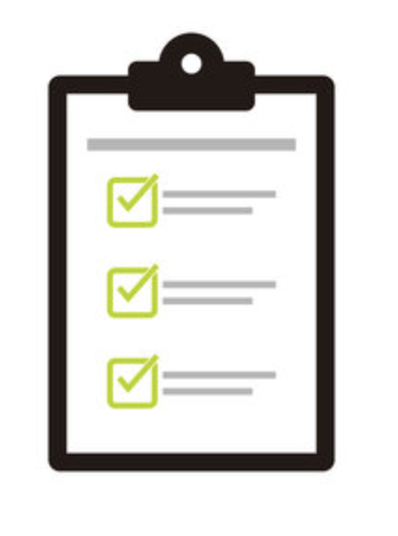
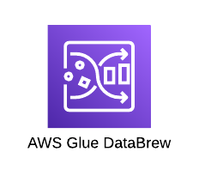

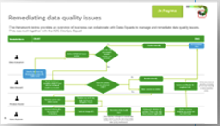

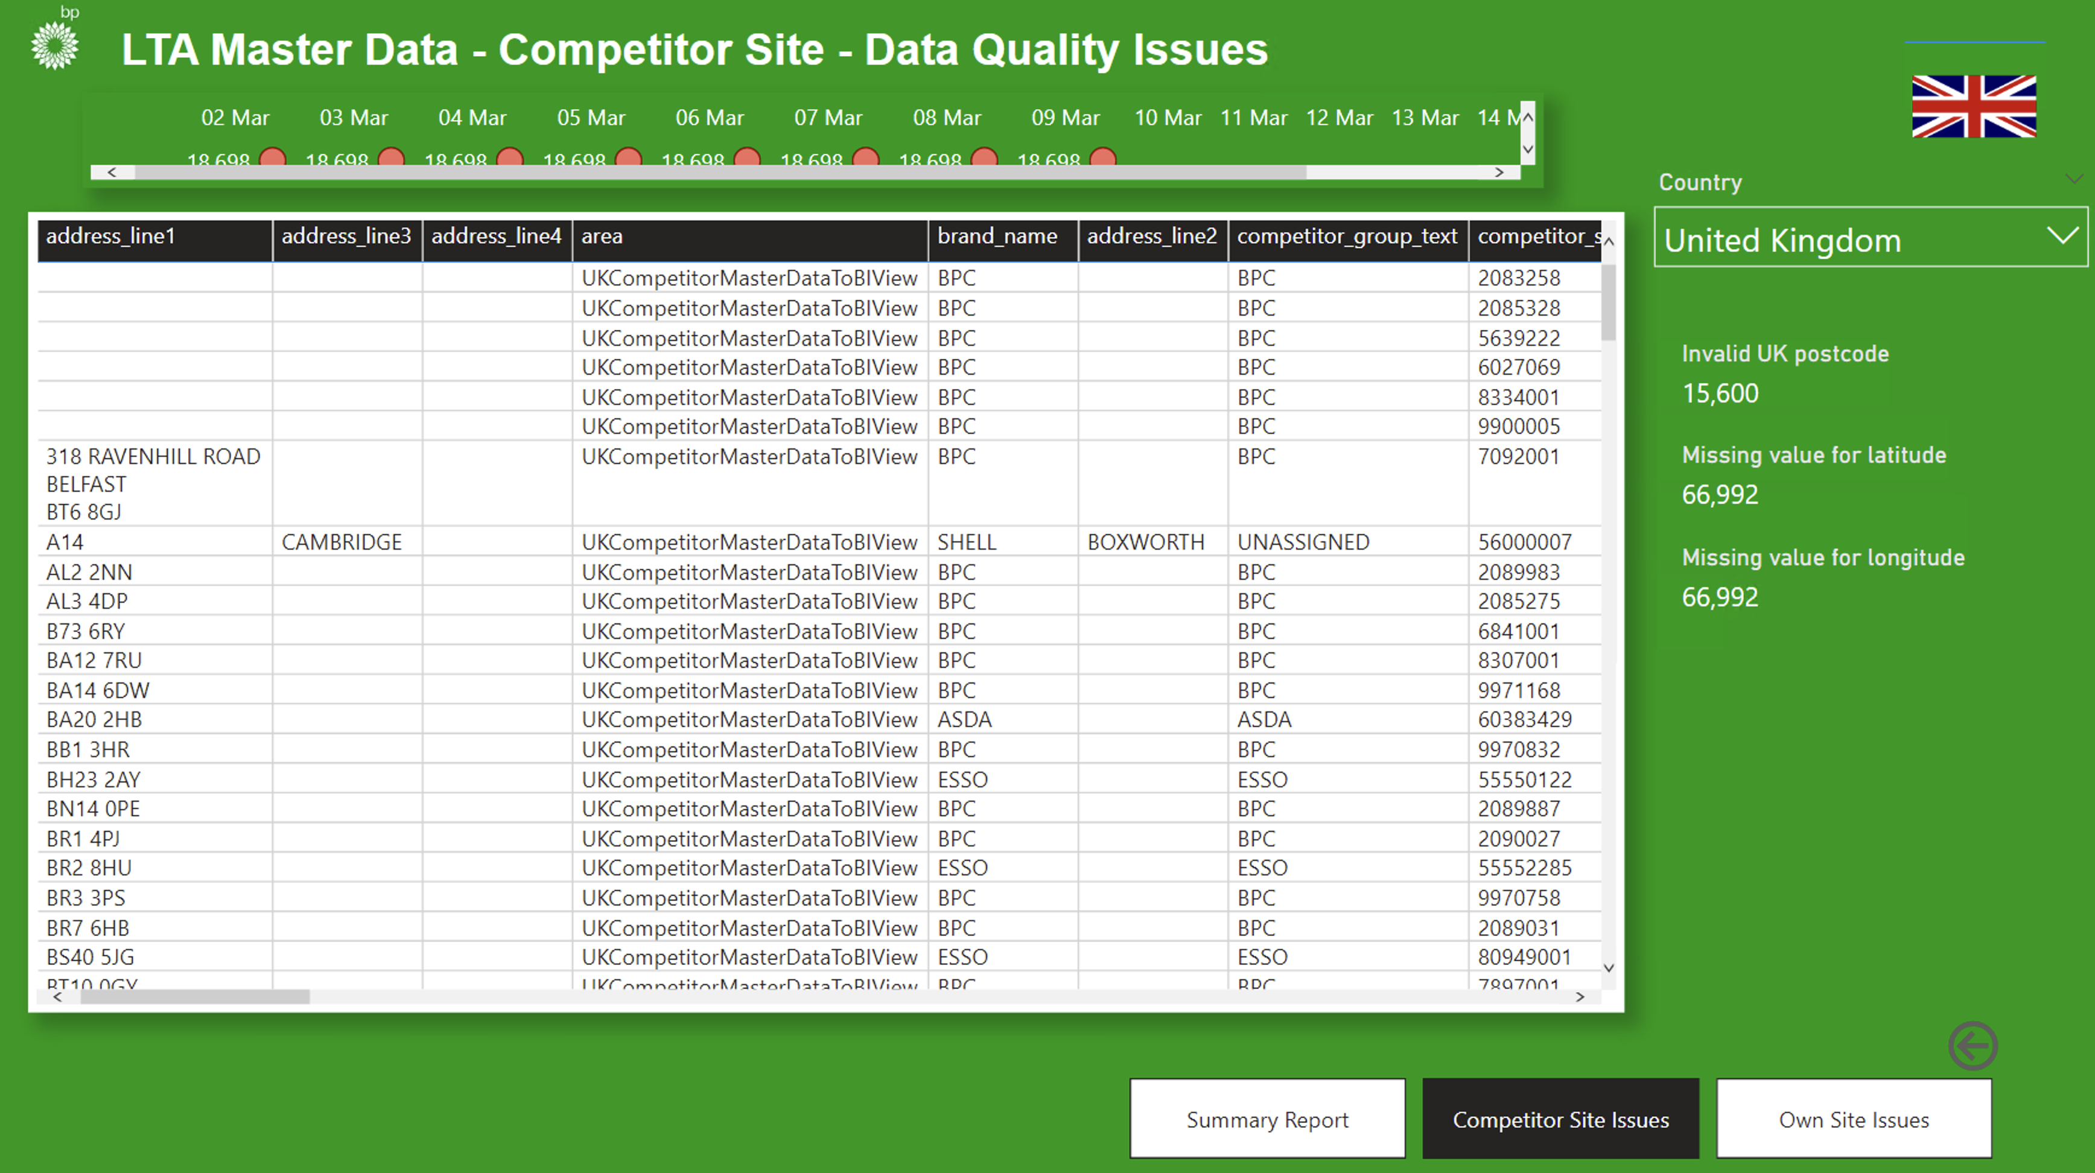

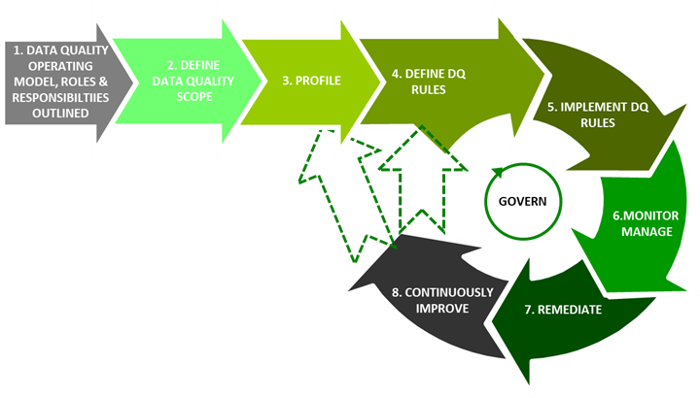
What is the Data Quality Framework?
A central, standardised and scalable Data Quality framework enabling businesses to identify and remediate their Data Quality issues
Objectives
Continuously improved and evolving according to business needs
1
A centralised configurable DQ Framework within GIPP delivering to business requirements
As A DATA OWNER, HOW CAN I IMPROVE & BUILD TRUST IN MY DATA QUALITY??
2
Build trust in our Data
List of data quality check types outlined and shared by Data owner
AWS DataBrew Data Profiling engine
Standard DQ Dashboard
Email Notification
Supporting Best practices & Processes
Enabled Identification and remediation of Data Quality issues
3
DQ Rules updated in the configurable JSON files
Industry Best practice data quality lifecycle outlined
4
Increased Velocity & Volume Delivery
Notes:
So what is included in the DQ Framework
The goal and objective is to ensure we have a scalable framework that is available to teams to use today – This includes Industry best practice data quality lifecycle outlined. So the step by step guide to improving your dq score
A centralised DQ repository which is shared and updated by all DevOps squads – With 4 checks already available – SHOWCASE
Standard dq rule metamodel and output metamodel – Prioritised to what we want to see. As a user we want to see Number of records we have checked, which % of records have failed, which dq rules have failed and for how long
Standard DQ Tooling – Evolved and updated with updates and a view of the current market continuously.
Standard DQ Dashboard – In this dashboard you can do….
Standard data platform architecture and solution concept
Supporting best practices to guide our people on how to do these activities.
Ultimately is an easily implemented, scalable, configurable package that can help teams identify their dq issues today.

Slide 5
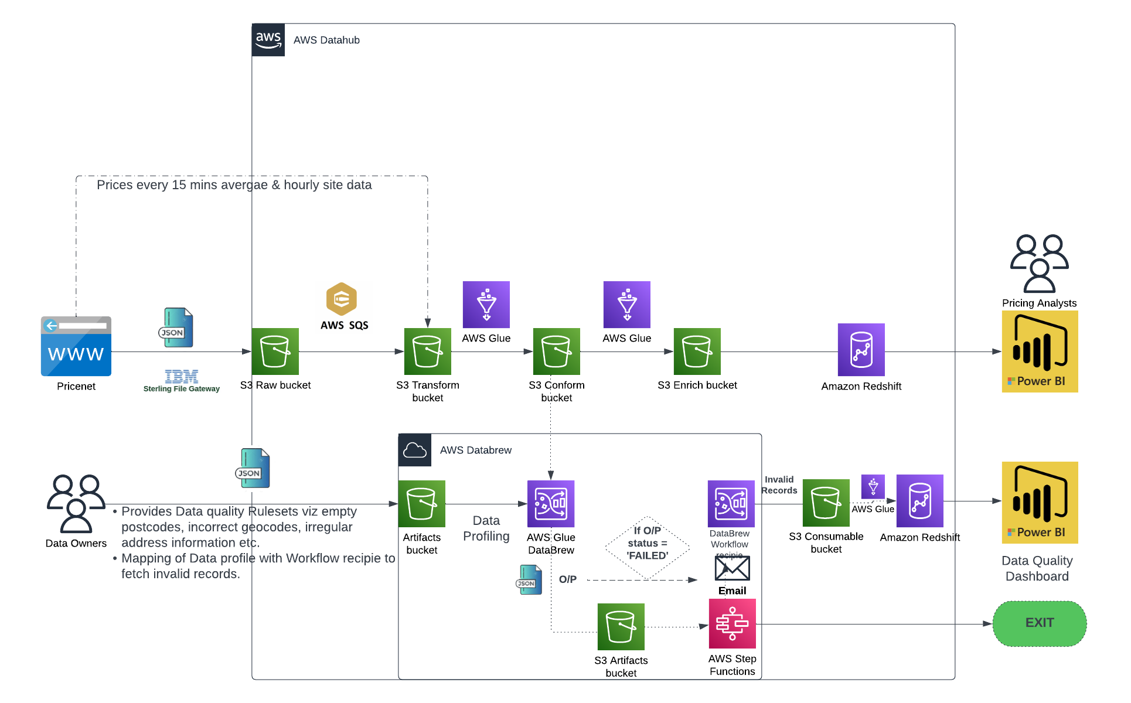
Data Quality Framework - Architecture
Notes:
Execution is severless

Slide 6
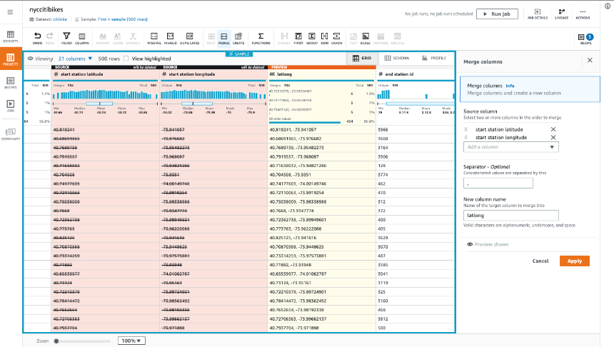
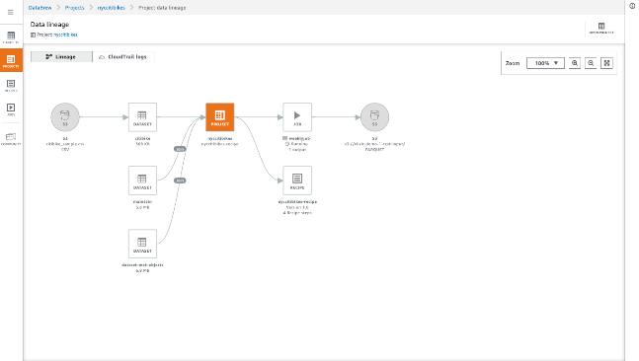
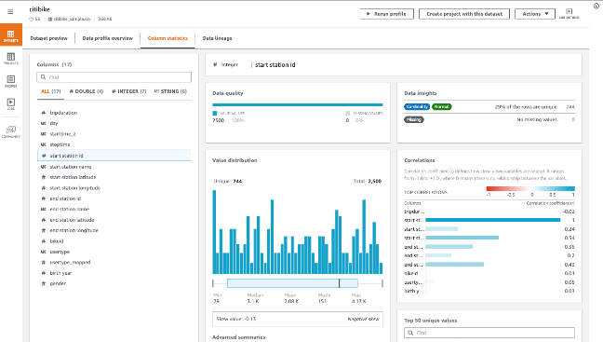
AWS Glue Data Brew- serverless, no code data wrangling
Visual lineage
Data quality dashboard
Easy access visual interfaces for Data Analysts

Slide 7
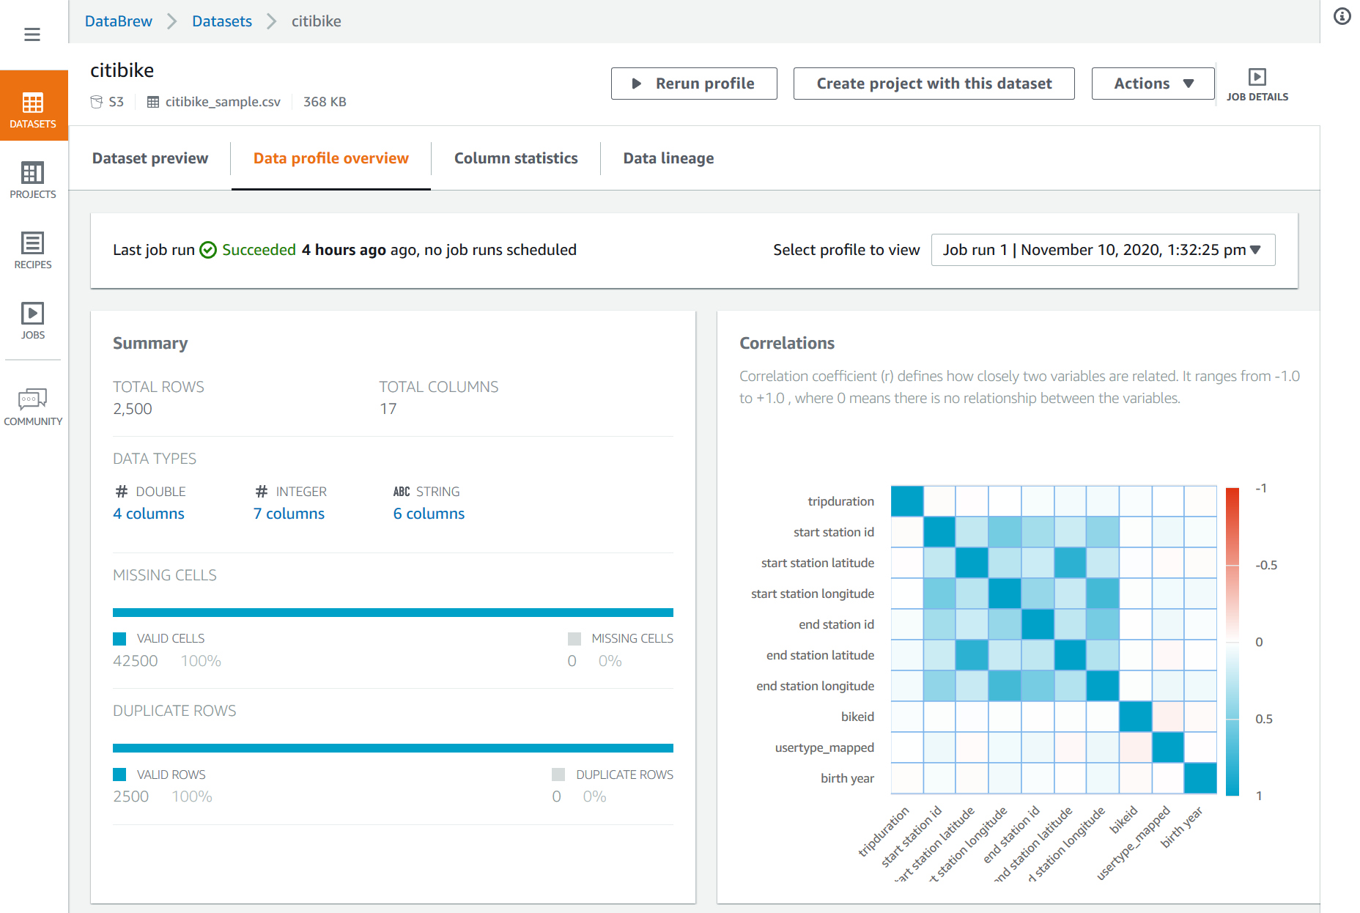
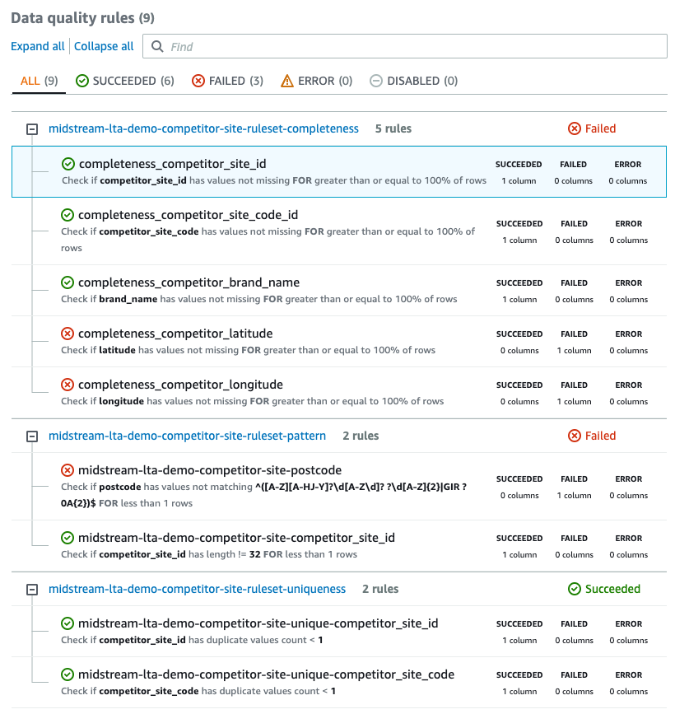
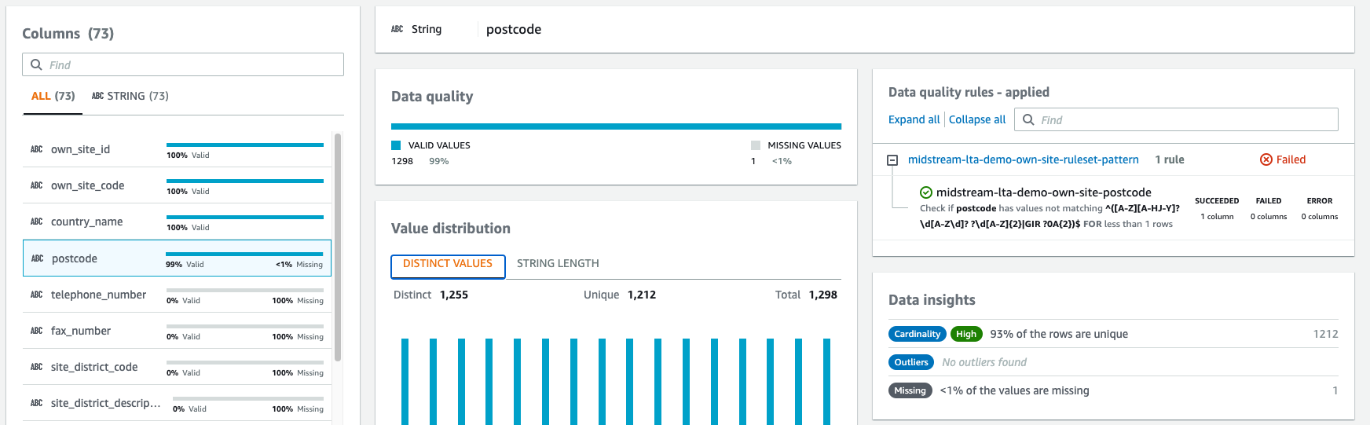
Data Quality monitoring using AWS Glue Data Brew
Generate Data Profiles for individual Data Sets
Check against custom Data Quality Rules
Investigate Column Statistics and Data Quality Issues

Slide 8
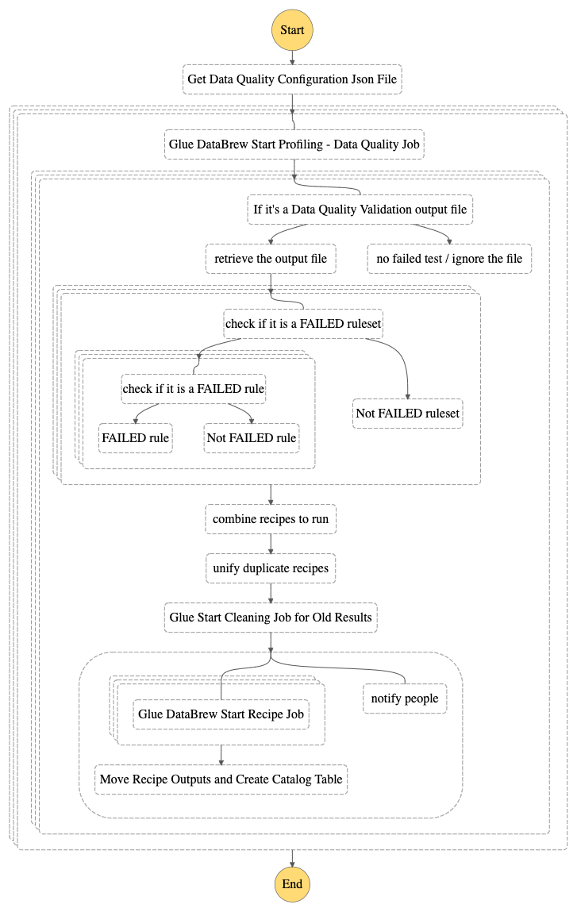
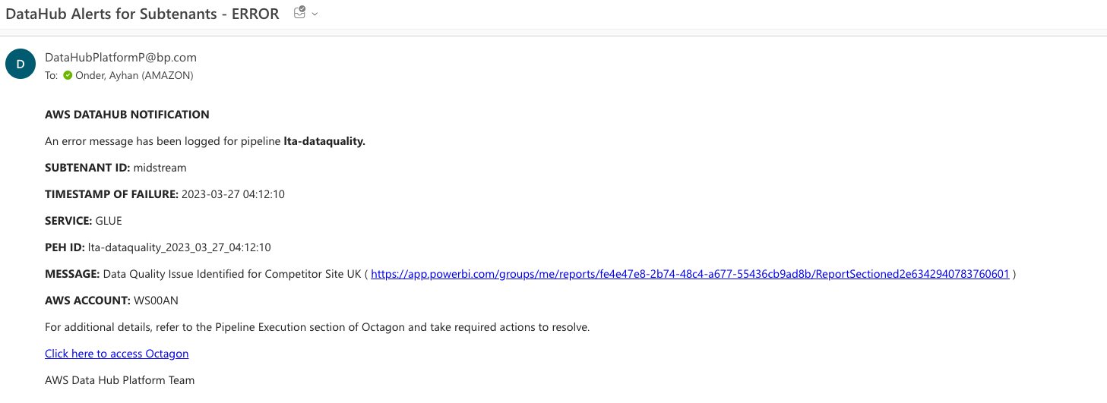
Automation within Datahub
Daily orchestration of configured Data Quality Profiling Jobs
Notification e-mail

Slide 9
DEMO…

Slide 10
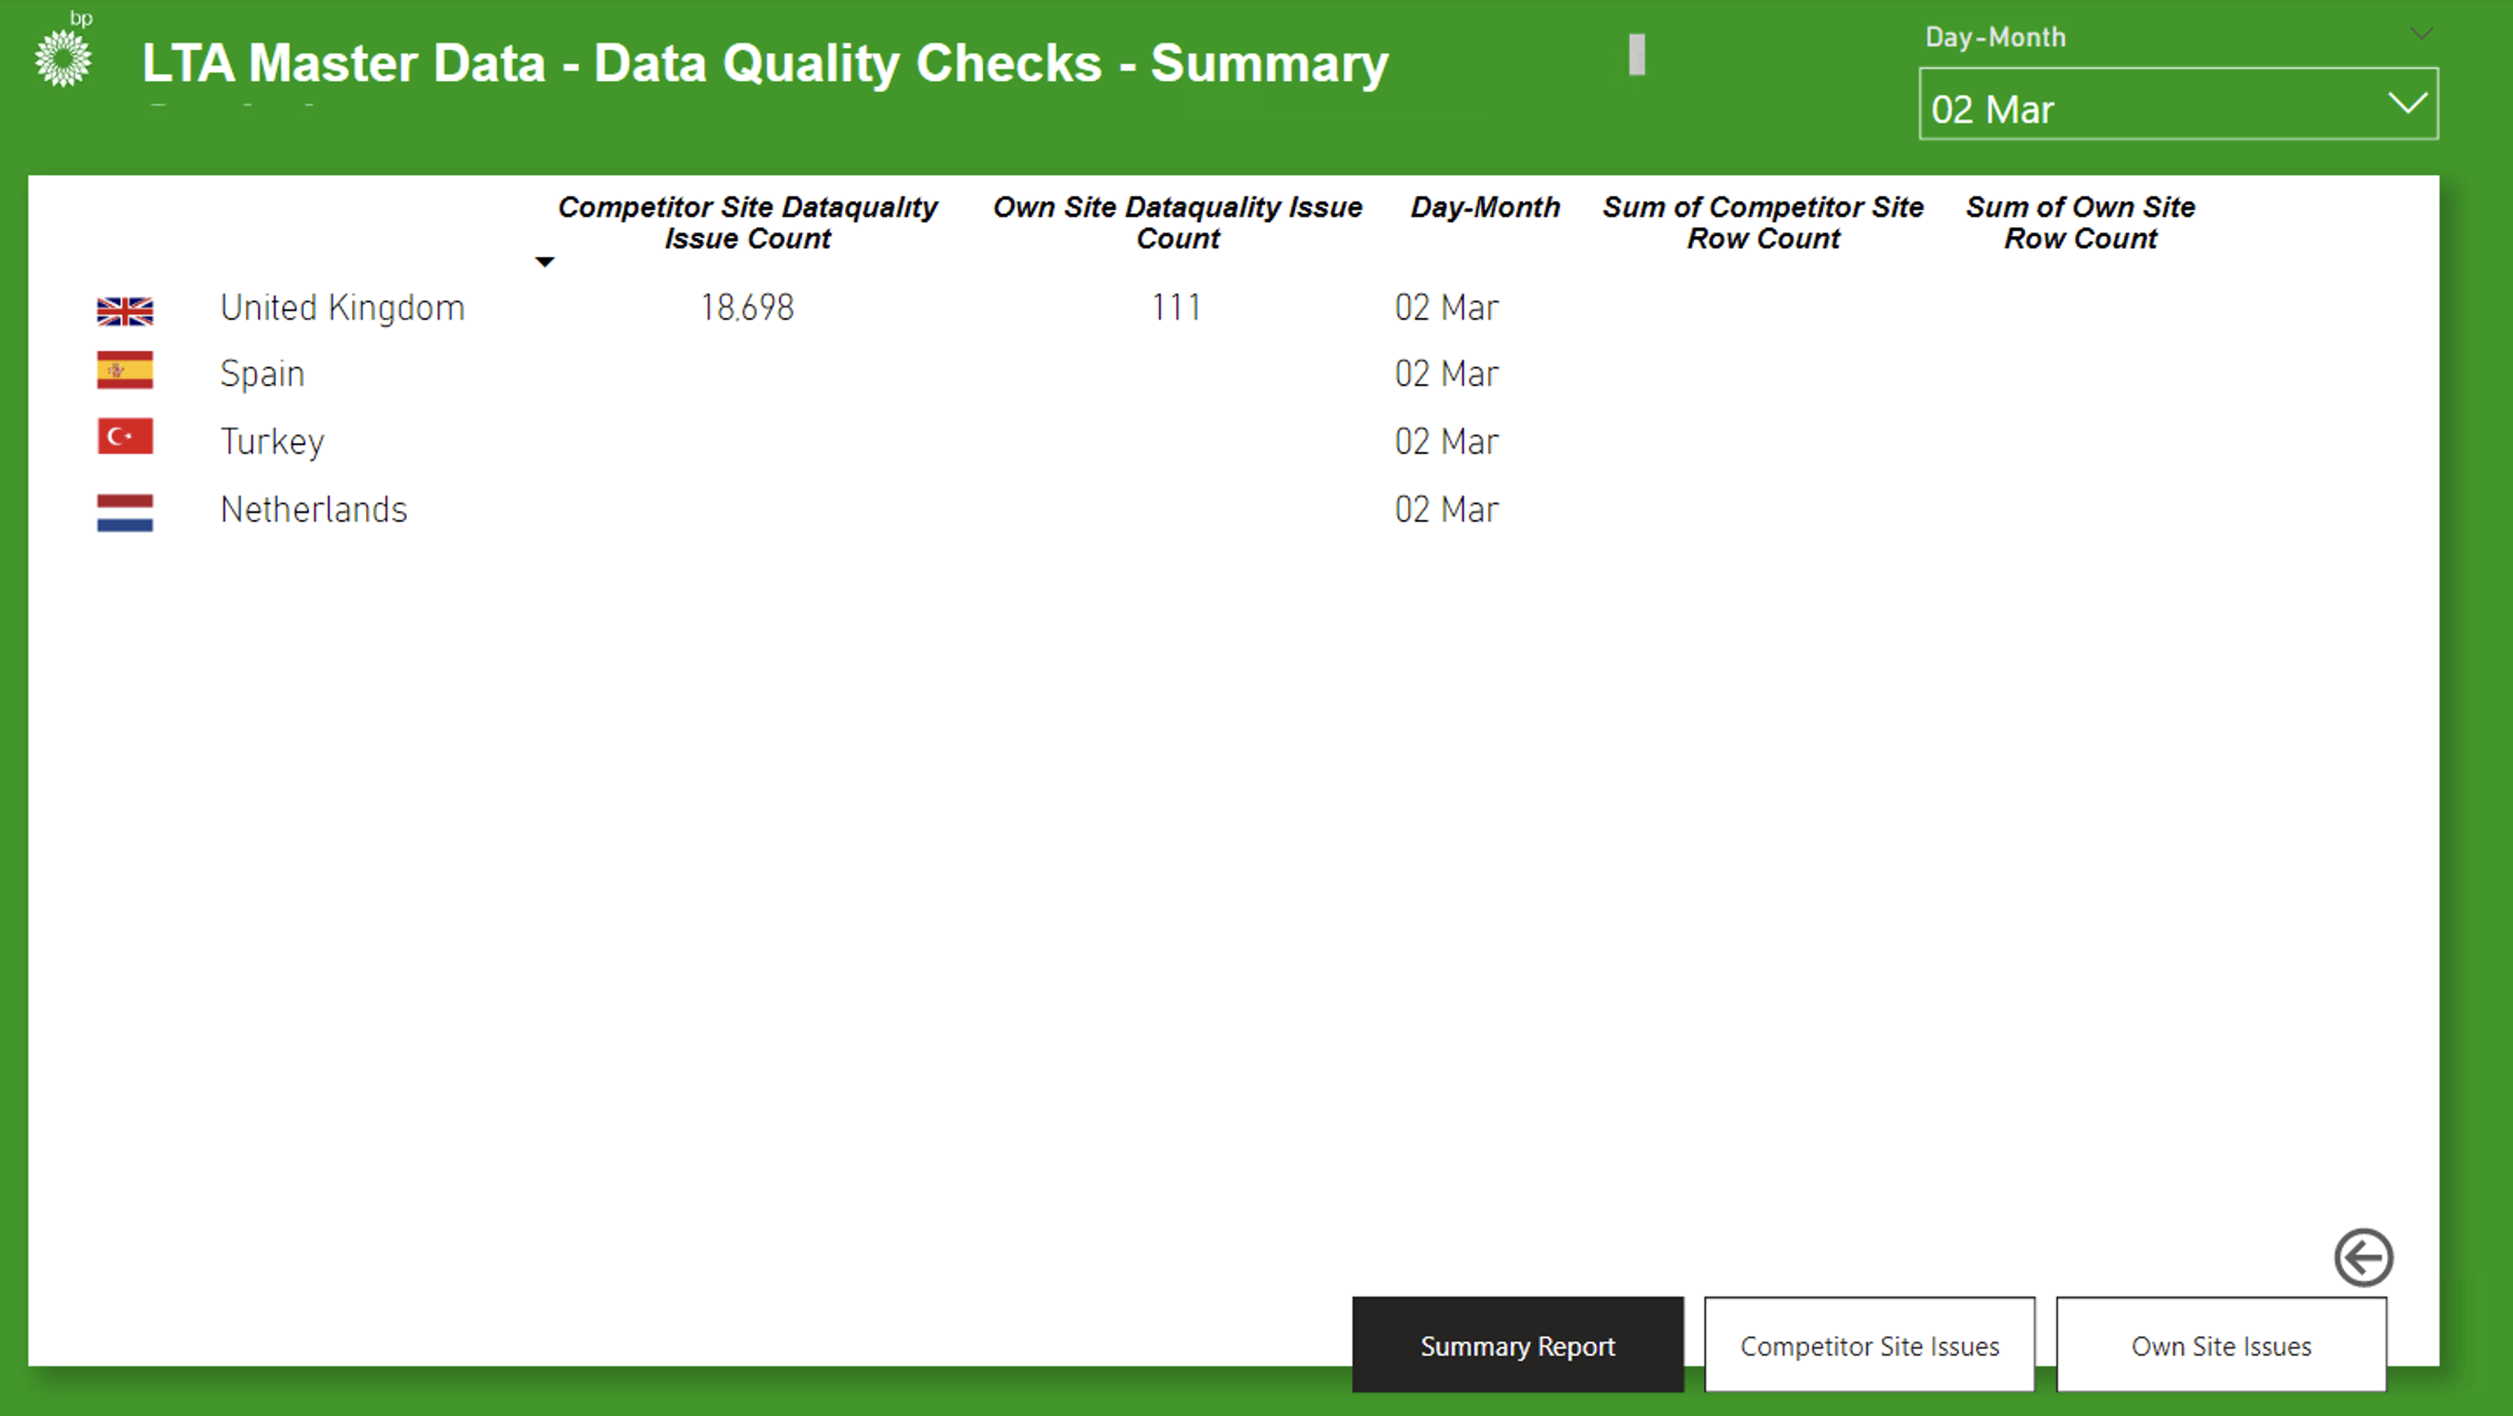
Proposed Data Quality visualisation dashboard – Prototype V1.0

Slide 11
Questions

